Slide 1
Introduction to CAPI for Population-Based Surveys
Notes:
Importance of paper/content first, CAPI second
Testing programs, learning the flow
Preparation – setting up CAPI system to control for interviewers, sample cluster and household identification (done by [CONTRACTOR] Data Manager)
Central Office – led by In-Country Data Manager

Slide 2
FTF CAPI System
CAPI – Computer Assisted Personal Interview
A system to help interviewers, supervisors, QC teams and the Central Office to collect, supervise and monitor the fieldwork operation
Written in CSPro language
Four systems in CAPI operations
Preparation – field teams, clusters, households
Interviewers - data collection
Supervisor - tracking of fieldwork progress
Central Office/QC teams - monitor fieldwork quality
Notes:
Importance of paper/content first, CAPI second
Testing programs, learning the flow
Preparation – setting up CAPI system to control for interviewers, sample cluster and household identification (done by [CONTRACTOR] Data Manager)
Central Office – led by In-Country Data Manager

Slide 3





Interviewer System
Updates, Module Sharing,
Transfer data to supervisor
Supervisor System
Supervisor
Supervisor
Central Office
System
Reports
Central Office (ICDM)
Notes:
Central Office (CAPI) is led by the in-country Data Manager
All red and black arrows indicate transfer of data and/or updates to systems. For arrows between supervisor and interviewers (and between interviewers), Bluetooth is used. For all other arrows, internet transfer is used.
For module sharing, updates, transferring data, all is WITHIN teams (teams don’t share outside of themselves)

Slide 4


Interviewer System
Menu application
Household interview
Identify required modules
Module sharing
Module interviews
Entering anthropometry
Identify eligible women, children
Backup to flash memory devices
Transfer data to supervisors/sharing data with the team
Get updates from supervisor
Backup memory cards
Int1
Int2
Int5
Data/Update Transfer
Supervisor

Slide 5
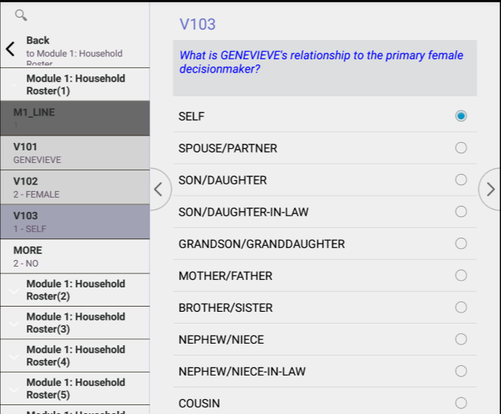
Data Entry Screen
Variable name
Question text
Questionnaire navigation
Answer choices

Slide 6
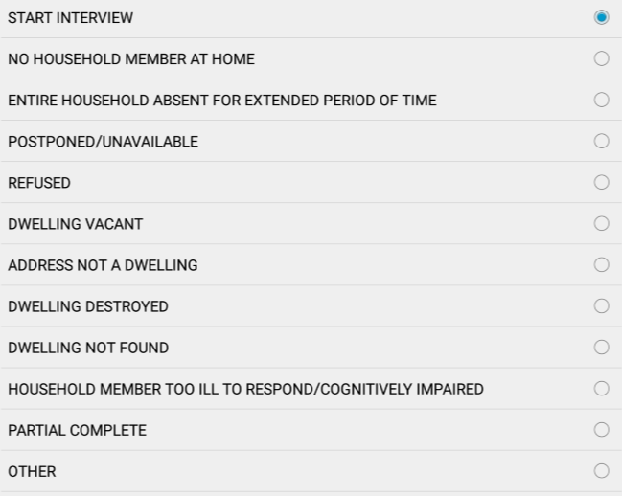
Data Entry Controls
Radio buttons – single response questions
Notes:
Only one choice may be selected!

Slide 7
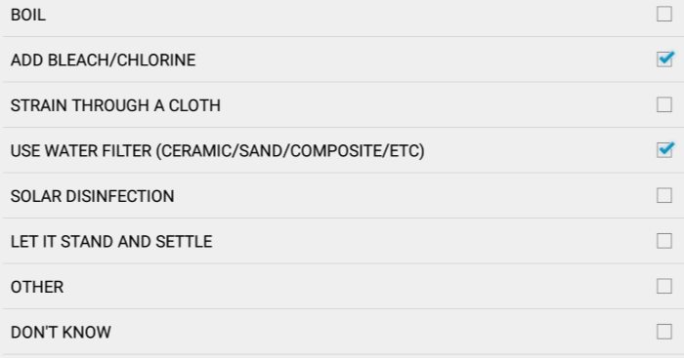
Data Entry Controls
Check Boxes – multiple response questions
Notes:
More than one choice may be selected!
With multiple response questions, options like “don’t know”, “no one”, “none”, etc are checked. If one of these answers is given, no other boxes may be checked.
When “other” is chosen, a separate screen will appear for the interviewer to enter the response given.

Slide 8
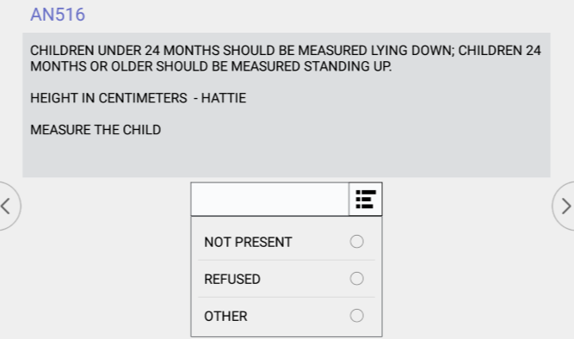
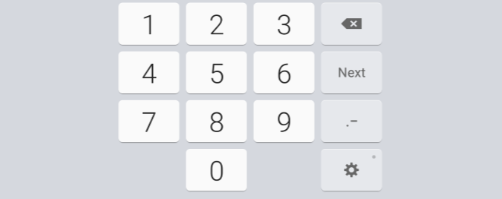
Data Entry Controls
Ranges of values – open response within range

Slide 9
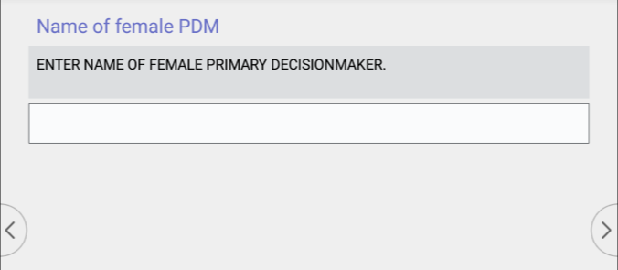

Data Entry Controls
Text Boxes – Names, addresses, other answers

Slide 10


Supervisor System Components
Menu application
Assign households to interviewers
Receive data from interviewers daily
Keeps track of status for every household
Checks data structure
Report overall summaries for the cluster
Send to central office using Dropbox
Get and distribute system updates
Backup data to flash memory devices
Data/Update Transfer
Supervisor
Backup
Central Office (ICDM)

Slide 11
Central Office System Components
Menu Application
Receive clusters from supervisors via Dropbox
Reports & structure checking by cluster
Run secondary editing programs by cluster and modify errors
Run field check tables
Monitor fieldwork operation by cluster or team
Review interviewer notes
Supervisor 1
Supervisor 2
Supervisor n
Central Office (ICDM)

Slide 12
Fieldwork Flow
Arrive in cluster, Identify households
Interviewers carry out module interviews, collect height/weight
Supervisor assigns households
Interviewers send data to supervisor
Interview HHs, identify eligible individuals
Team resolves structural problems
Interviewer A assigns modules to Interviewer B
Supervisor submits data to central office
Notes:
Quick look at the flow of field work from start to finish in a cluster – training will refer back to this chart regularly

